Slide 1
Black Holes

Slide 2
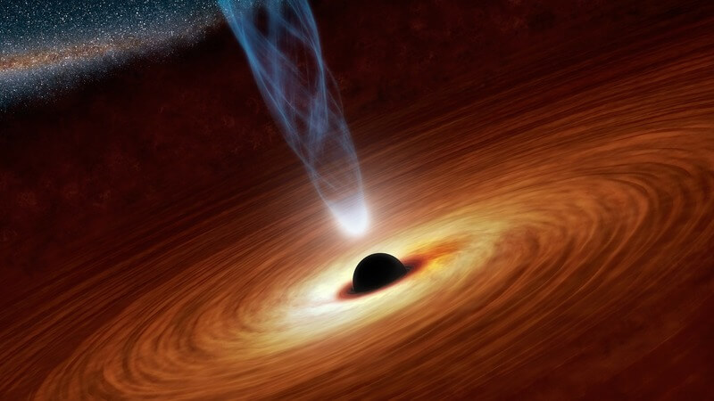
After you’ve read this passage, you should be able to:
Describe a black hole.
Describe the effect of a black hole on space-time.
Explain the theories on what would happen when falling into a black hole.

Slide 3
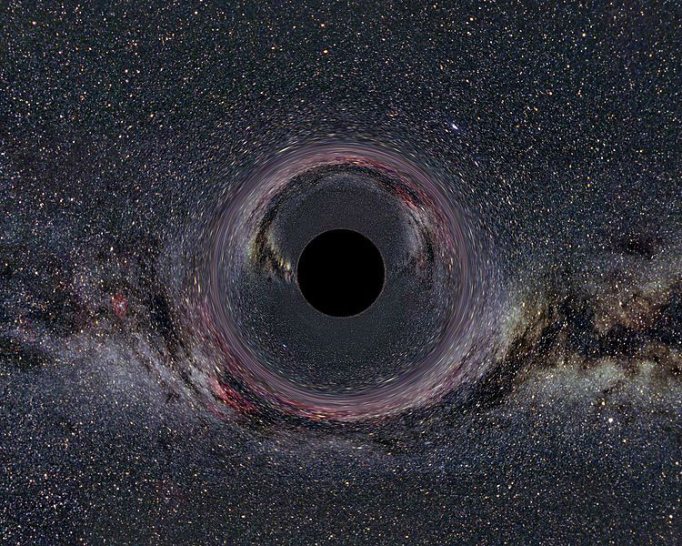
Black holes are one of the most mysterious objects in outer space.
A black hole is a region of space from which nothing can escape, not even light!
Black holes get their name because they reflect no light; all light that would illuminate them is trapped inside.

Slide 4
Black Holes
When a star runs out of the nuclear fuel it uses to generate energy, it dies in one of several ways. Moderately sized stars, like the Sun, will slowly expand into a red giant before shedding the outer layers until only the core remains as a white dwarf star. These white dwarf stars are very dense, containing most of the mass of the Sun in a volume the size of Earth. However, stars much larger than our Sun die much more violently and leave behind even denser remains.
These massive stars eventually explode in a supernova. The core of these stars has fused atoms together to create iron, but fusing iron atoms consumes more energy than is produced. The core is no longer releasing energy and collapses under the force of gravity. This collapse releases the gravitational potential energy of the core as kinetic energy, exploding the outer layers of the star.

Slide 5
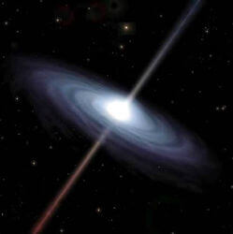
If the original star was a mere 10 to 30 times the mass of our Sun, the core will collapse into a neutron star. These dense remnants contain twice the mass of the Sun in a sphere with a radius of just 10km.
The core of an even larger star experiences an even greater gravitational force pulling it in on itself. This force is so strong that nothing can stop it collapsing and all the mass of the core is pulled into an infinitesimal volume called a singularity. A black hole has been formed.

Slide 6
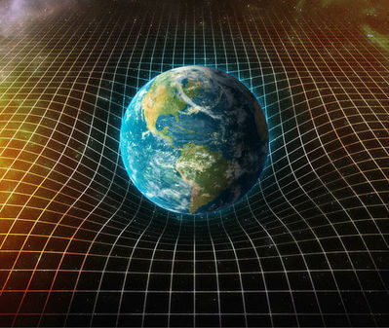
Despite what science fiction purports, black holes don’t pull things in with any more force than another object of the same mass. If the Sun was to suddenly be replaced with a black hole of the same mass, none of the orbits of planets in our solar system would change.
So what’s so special about black holes if they don’t pull in everything around them? To understand this, we need to introduce the concept of spacetime. One of Albert Einstein’s many contributions to science was the idea that the spatial dimensions (x, y and z on graphs) and time are connected, and together can be thought of as a sort of sheet that is warped by massive objects. Gravity, then, is just the result of this bent medium through which we travel.

Slide 7
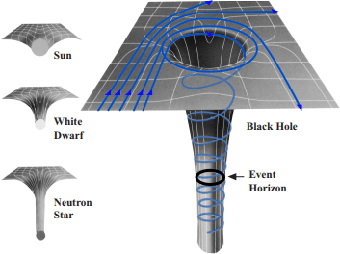
The denser something is, the more drastic the warping is. A black hole is sufficiently dense that the walls of the space-time pit are vertical below the event horizon. This is why escaping from inside a black hole is impossible, it’d be like climbing out of a pit with perfectly smooth walls.
Another consequence of this curved space-time is that the closer you are to the black hole, the slower time passes for you. As someone falls into a black hole, they perceive the rest of the universe to be whizzing forwards in time. To an outside observer however, the person falling into the black hole would be seen inexorably approaching the event horizon, but never crossing it.

Slide 8

What actually happens to someone when they cross the event horizon is a matter of ongoing debate. Some theories predict that as soon as you cross the event horizon, you're vaporised into elemental particles.
Other theories predict that nothing dramatic happens. You just continue falling. But as you fall further in, the difference in the strength of gravity over the length of your body causes your feet to accelerate faster than your head, stretching you out like a piece of spaghetti. Eventually this spaghettification will rip you apart and then rip your cells and molecules apart too.
Fortunately, the nearest black hole is light years away, so the chances of you ever experiencing either result are extremely low.

Slide 9
Reference List:
NASA. (2017). Black Holes. Retrieved from: https://science.nasa.gov/astrophysics/focus-areas/black-holes. Date retrieved: 2017-08-14.
National Geographic. (2014). Star Eater. Retrieved from: http://www.nationalgeographic.com/magazine/2014/03/black-holes-einstein-star-eaters/. Date retrieved: 2017-08-14.
NASA. (2001). The Anatomy of Black Holes. Retrieved from: https://imagine.gsfc.nasa.gov/educators/blackholes/imagine/imagine_book.pdf. Date retrieved: 2017-08-14.
Celotti, A., Miller, J. C. & Sciama, D. W. (1999). Astrophysical evidence for the existence of black holes. arXiv:astro-ph/9912186.
Heger, A., Fryer, C. L., Woosley, S. E., Langer, N., & Hartmann, D. H. (2002). How Massive Single Stars End their Life. arXiv:astro-ph/0212469.
Richmond, M. Late stages of evolution for low-mass stars. Retrieved from: http://spiff.rit.edu/classes/phys230/lectures/planneb/planneb.html. Date retrieved: 2017-08-15.
Miller, M. C. Introduction to neutron stars. Retrieved from: http://www.astro.umd.edu/~miller/nstar.html. Date retrieved: 2017-08-15.

